Slide 1
CS2100 Tutorial 11
Cache
While waiting, do fill the end-of-sem feedback
https://blue.nus.edu.sg
Slides by Theodore, adapted from Prof. Aaron’s slides

Slide 2
Recap
K-maps
minterm and Maxterm
Boolean Algebra laws

Slide 3
Overview
Q1) Control values
Q2) Critical path / time calculation
Q3) Messing up inputs and hypotheticals

Slide 4
Q1.
4, 16, 32, 20, 80, 68, 76, 224, 36, 44, 16, 172, 20, 24, 36, 68.
MIPS: 1 word = 4 bytes
1 block = 1 word
16 blocks total
Direct-mapped cache
Offset = ?
2 bits
Index = ?
4 bits
Index
Offset
4: 00…00 0001 00
16: 00…00 0100 00
32: 00…00 1000 00
20: 00…00 0101 00
80: 00…01 0100 00
68: 00…01 0001 00
76: 00…01 0011 00
224: 00…11 1000 00
36: 00…00 1001 00
44: 00…00 1011 00
16: 00…00 0100 00
172: 00…10 1011 00
20: 00…00 0101 00
24: 00…00 0110 00
36: 00…00 1001 00
68: 00…01 0001 00
Index | Valid | Tag | Word
0 | 0
1 | 0
2 | 0
3 | 0
4 | 0
5 | 0
6 | 0
7 | 0
Index | Valid | Tag | Word
8 | 0
9 | 0
10 | 0
11 | 0
12 | 0
13 | 0
14 | 0
15 | 0

Slide 5
Q1.
4, 16, 32, 20, 80, 68, 76, 224, 36, 44, 16, 172, 20, 24, 36, 68.
MIPS: 1 word = 4 bytes
1 block = 1 word
16 blocks total
Direct-mapped cache
Offset = ?
2 bits
Index = ?
4 bits
Index
Offset
4: 00…00 0001 00
16: 00…00 0100 00
32: 00…00 1000 00
20: 00…00 0101 00
80: 00…01 0100 00
68: 00…01 0001 00
76: 00…01 0011 00
224: 00…11 1000 00
36: 00…00 1001 00
44: 00…00 1011 00
16: 00…00 0100 00
172: 00…10 1011 00
20: 00…00 0101 00
24: 00…00 0110 00
36: 00…00 1001 00
68: 00…01 0001 00
Index | Valid | Tag | Word
0 | 0
1 | 0
2 | 0
3 | 0
4 | 0
5 | 0
6 | 0
7 | 0
Index | Valid | Tag | Word
8 | 0
9 | 0
10 | 0
11 | 0
12 | 0
13 | 0
14 | 0
15 | 0
1
0
M[32]
M[224]
3
1
0
M[4]
M[68]
1
0
1
M[36]
1
1
M[76]
1
0
M[172]
2
M[44]
1
0
M[16]
M[80]
M[16]
1
0
1
0
M[20]
1
0
M[24]
Hit
Hit
Hit

Slide 6
Q2.
4, 16, 32, 20, 80, 68, 76, 224, 36, 44, 16, 172, 20, 24, 36, 68.
MIPS: 1 word = 4 bytes
1 block = 2 words
16 words total = 8 blocks in total
2-way set associative
LRU replacement
Offset = ?
Set index
3 bits
Set index = ?
2 bits
Offset
4: 00…000 00 100
16: 00…000 10 000
32: 00…001 00 000
20: 00…000 10 100
80: 00…010 10 000
68: 00…010 00 100
76: 00…010 01 100
224: 00…111 00 000
36: 00…001 00 100
44: 00…001 01 100
16: 00…000 10 000
172: 00…101 01 100
20: 00…000 10 100
24: 00…000 11 000
36: 00…001 00 100
68: 00…010 00 100
Set | Valid | Tag | Word0 | Word1 | Valid | Tag | Word0 | Word1
0 | 0 |  |  |  | 0
1 | 0 |  |  |  | 0
2 | 0 |  |  |  | 0
3 | 0 |  |  |  | 0
4

Slide 7
Q2.
4, 16, 32, 20, 80, 68, 76, 224, 36, 44, 16, 172, 20, 24, 36, 68.
MIPS: 1 word = 4 bytes
1 block = 2 words
16 words total = 8 blocks in total
2-way set associative
LRU replacement
Offset = ?
Set index
3 bits
Set index = ?
2 bits
Offset
4: 00…000 00 100
16: 00…000 10 000
32: 00…001 00 000
20: 00…000 10 100
80: 00…010 10 000
68: 00…010 00 100
76: 00…010 01 100
224: 00…111 00 000
36: 00…001 00 100
44: 00…001 01 100
16: 00…000 10 000
172: 00…101 01 100
20: 00…000 10 100
24: 00…000 11 000
36: 00…001 00 100
68: 00…010 00 100
Set | Valid | Tag | Word0 | Word1 | Valid | Tag | Word0 | Word1
0 | 0 |  |  |  | 0
1 | 0 |  |  |  | 0
2 | 0 |  |  |  | 0
3 | 0 |  |  |  | 0
Hit
1
0
M[0]
M[4]
1
1
M[32]
M[36]
2
M[64]
M[68]
7
M[224]
M[228]
1
M[32]
M[36]
2
M[64]
M[68]
1
2
M[72]
M[76]
1
1
M[40]
M[44]
5
M[168]
M[172]
1
0
M[16]
M[20]
1
2
M[80]
M[84]
Hit
Hit
1
0
M[24]
M[28]
Hit
4

Slide 8
Q3.
# | Code
i1 | addi $s0, $zero, 0
i2 | addi $s1, $s5, -1
i3 | addi $s3, $zero, 1
i4 | loop: slt $t0, $s0, $s1
i5 | beq $t0 $zero, exit
i6 | beq $s3, $zero, exit
i7 | addi $t1, $s4, $s0
i8 | lb $t4, 0($t3)
i9 | addi $t3, $s4, $s1
i10 | lb $t4, 0($t3)
i11 | beq $t2, $t4, else
i12 | addi $s3, $zero, 0
i13 | j endW
i14 | else: addi $s0, $s0, 1
i15 | addi $s1, $s1, -1
i16 | endW: j loop
i17 | exit: [some instruction]
Tracing the first 10 iterations of the code
Assuming the string is a palindrome
First iteration:
i1 – i11, (skip i12 – i13), i14 – i16
Subsequent iterations:
i4 – i11, (skip i12 – i13), i14 – i16

Slide 9
Q3.
First iteration: i1 – i11, i14 – i16
Direct mapped cache: 2 blocks, each 16 bytes
Show instruction cache content at end of 1st iteration
Calculate total cache hits after 10 iterations
Subsequent iterations: i4 – i11, i14 – i16
First iteration:
inst | H/M?
i1
M
Offset = 4 bits; Index = 1 bit
i2
H
Addr. of i1: 0x4 = 00…000 0 0100 → index 0, word 1
i3
H
Cache block 0
Cache block 1
i4
M
i0
i8
i16
i1
i9
i17
i2
i10
i18
i3
i11
i19
i5
H
i4
i12
i5
i13
i6
i14
i7
i15
i6
H
Subsequent iterations
i7
H
First iteration: 9 hits
Each of next 9 iterations: 7 hits
Total hits = 9 + (7 × 9) = 72
i8
M
i9
H
i10
H
i11
H
i14
M
i15
H
i16
M

Slide 10
Q3.
First iteration: i1 – i11, i14 – i16
Direct mapped cache: 4 blocks, each 8 bytes
Show instruction cache content at end of 1st iteration
Calculate total cache hits after 10 iterations
Subsequent iteration: i4 – i11, i14 – i16
First iteration:
Subsequent iterations:
i16
i17
inst | H/M?
inst | H/M?
Cache block 0
Cache block 1
Cache block 2
Cache block 3
i0
i8
i16
i8
i1
i9
i17
i9
i1
M
i4
H
i2
i10
i3
i11
i2
M
i5
H
i4
i5
i3
H
i6
M
i4
M
i7
H
i6
i14
i6
i14
i7
i15
i7
i15
i5
H
i8
M
i6
M
i9
H
First iteration: 6 hits
Each of next 9 iterations: 7 hits
Total hits = 6 + (7 × 9) = 69
i7
H
i10
H
i8
M
i11
H
i9
H
i14
M
i10
M
i15
H
i11
H
i16
M
i14
M
i15
H
i16
M

Slide 11
Q3.
s[0..7]
s[8..15]
s[16..23]
s[24..31]
s[32..39]
s[40..47]
s[48..55]
s[56..63]
Direct mapped cache: 2 blocks, each 8 bytes
String is 64-character long and is a palindrome; first character at 0x1000
Final content of data cache
Hit rate
s[0]
s[2]
s[61]
s[63]
R
E
A
D
Y
…
Y
D
A
E
R
tag
index
offset
s[1]
s[62]
1 bit
3 bits
Access pattern: s[0], s[63], s[1], s[62], …, s[31], s[32]
s[48..55]
s[16..23]
s[32..39]
char | H/M?
Cache block 0
Cache block 1
s[0..7]
s[0]
M
Addr 0x1000 → block 0
s[56..63]
s[8..15]
s[40..47]
s[24..31]
s[63]
M
Addr 0x103F → block 1
For each block, first character is a miss, the remaining 7 characters accessed are hits.
Total % hits = 7/8= 87.5%
s[1]
H
s[62]
H
:
s[8]
M
s[55]
M
:

Slide 12
Q3.
s[0..7]
s[8..15]
s[16..23]
s[24..31]
s[32..39]
s[40..47]
s[48..55]
s[56..63]
s[64..71]
Direct mapped cache: 2 blocks, each 8 bytes
String is 72-character long and is a palindrome; first character at 0x1000
Hit rate
s[0]
s[2]
s[69]
s[71]
R
E
A
D
Y
…
Y
D
A
E
R
tag
index
offset
s[1]
s[70]
1 bit
3 bits
Access pattern: s[0], s[71], s[1], s[70], …, s[35], s[36]
s[64..71]
s[0..7]
s[64..71]
char | H/M?
Cache block 0
Cache block 1
s[0..7]
s[0]
M
Addr 0x1000 → block 0
s[8..15]
s[56..63]
s[8..15]
s[56..63]
s[71]
M
Addr 0x1047 → block 0!
Data that go into cache block 0: s[0..7], s[64..71], s[16..23], s[48..55], s[32..39]
Data that go into cache block 1: s[8..15], s[56..63], s[24..31], s[40..47]
This is known as cache thrashing.
s[1]
M
s[70]
M
:
s[8]
M
Addr 0x1008 → block 1
s[63]
M
Addr 0x103F → block 1!
s[9]
M
Only 7 hits in the last examined block s[32..39] → 7/72 = 9.72%
s[62]
M
:

Slide 13
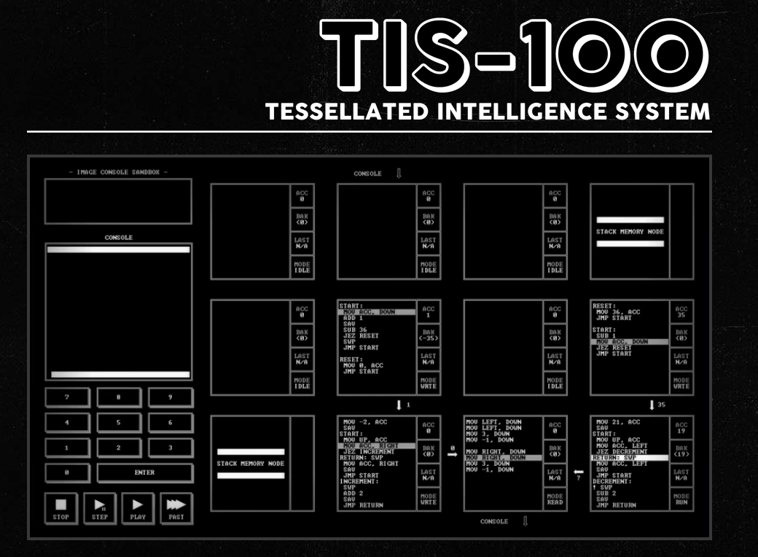
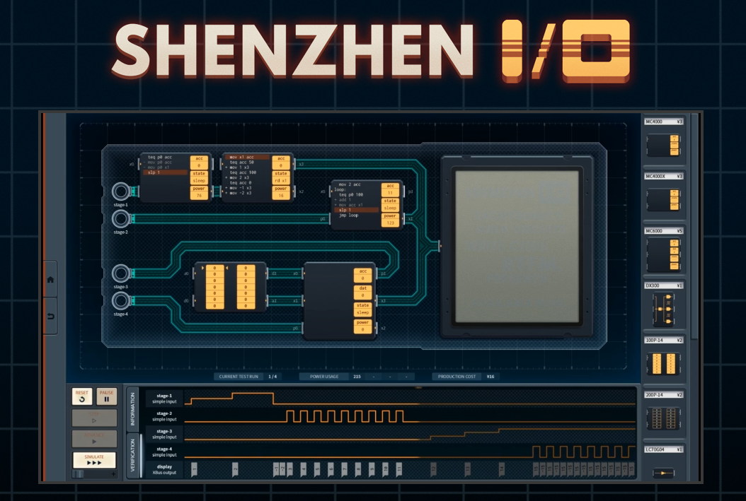

Bonus: Beyond CS2100
MIPS
Was and is used for some microprocessors
Current: Loongson / LoongArch is MIPS-compatible
Numerous other architectures besides MIPS! x86/x86-64, ARM/Arm-64, RISC V, …
If you’re interested in more assembly stuff:
CS4212 Compiler Design – you’ll make your own C to x86-lite compiler
CS2106 and some CEG Courses
A bunch of assembly games (check them out on Steam) (not sponsored or endorsed by me)

Slide 14
Bonus: Beyond CS2100
Logic Circuit
Not going to see this much if you’re taking CS
If interested in this – look into CG / EE-coded courses; may be able to audit
Caching
If you are going to take CS2106 (Operating Systems), you will see something really similar under the Paging topic
Idea is the same -- put data somewhere fast if you access it multiple times
More replacement policies beyond LRU

Slide 15

End of Tutorial 11
Slides uploaded on github.com/theodoreleebrant/TA-2425S1
Email: theo@comp.nus.edu.sg
Anonymous feedback:
bit.ly/feedback-theodore
(or scan on the right)
All the best for exams!
(Also reminder for me to take attendance)

